Slide 1
Analytical Theory and Methods

Slide 2
Unit II
Chap No | Chapter Details
 | Analytical Theory and Methods: Clustering and Associated Algorithms, Association Rules, Apriori Algorithm, Candidate Rules, Applications of Association Rules, Validation and Testing, Diagnostics, Regression, Linear Regression, Logistic Regression, Additional Regression Models.

Slide 3
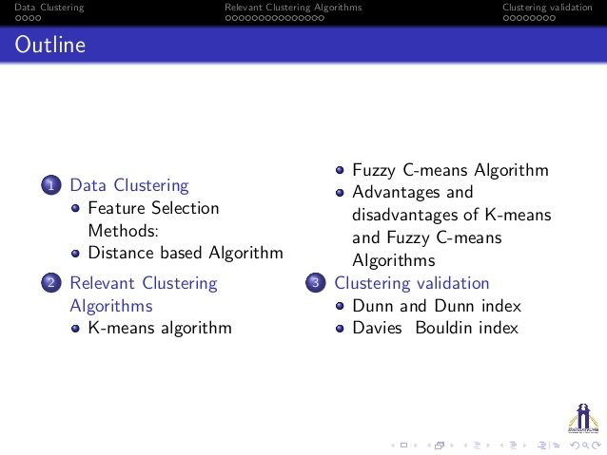

Slide 4
Clustering
clustering is the use of unsupervised techniques for grouping similar objects.
Clustering techniques are unsupervised in the sense that the data scientist does not determine, in advance, the labels to apply to the clusters.
For example, based on customers' personal income, it is straightforward to divide the customers into three groups depending on arbitrarily selected values. The customers could be divided into three groups as follows:
• Earn less than $10,000
• Earn between 510,000 and $99,999
• Earn $100,000 or more

Slide 5
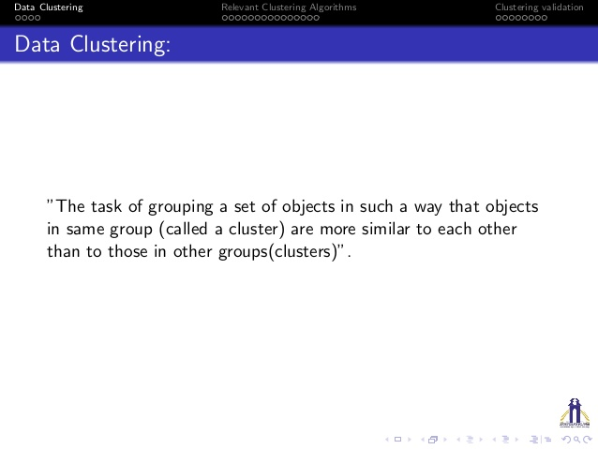

Slide 6
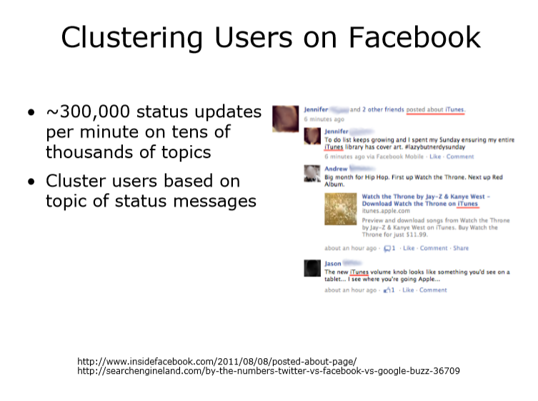

Slide 7
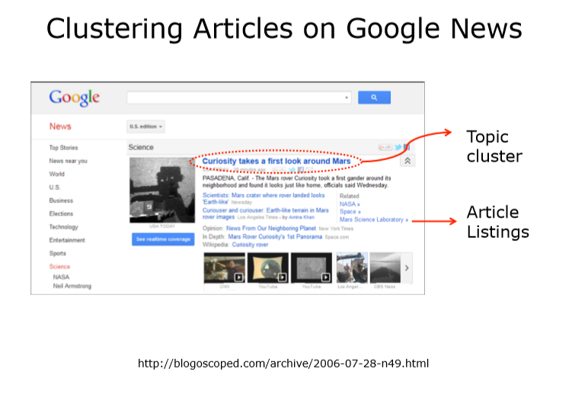

Slide 8
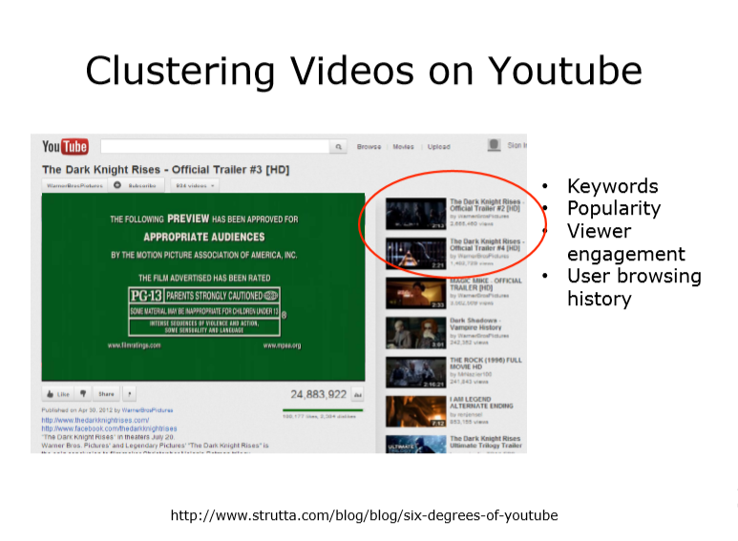

Slide 9
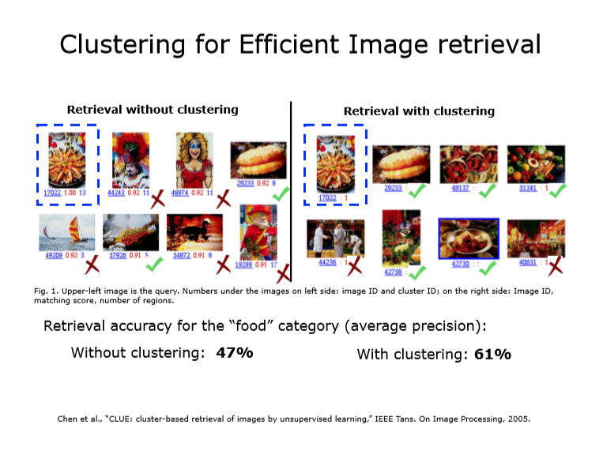

Slide 10
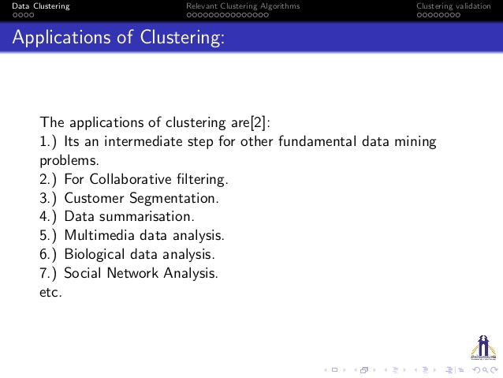

Slide 11
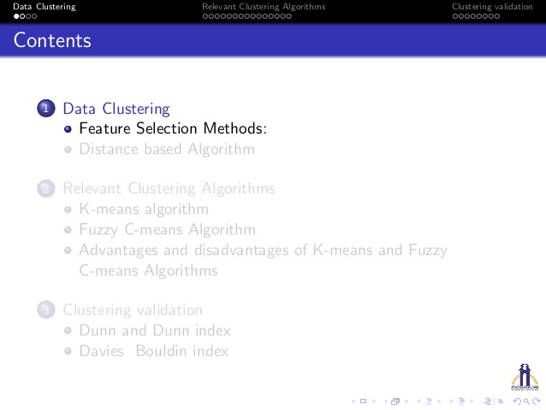

Slide 12
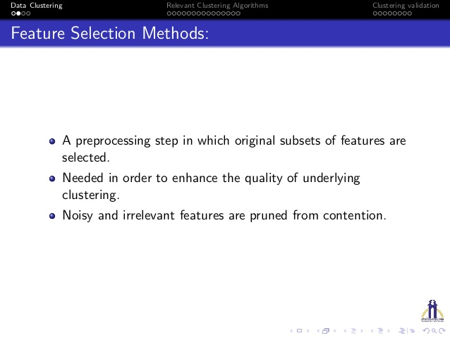

Slide 13
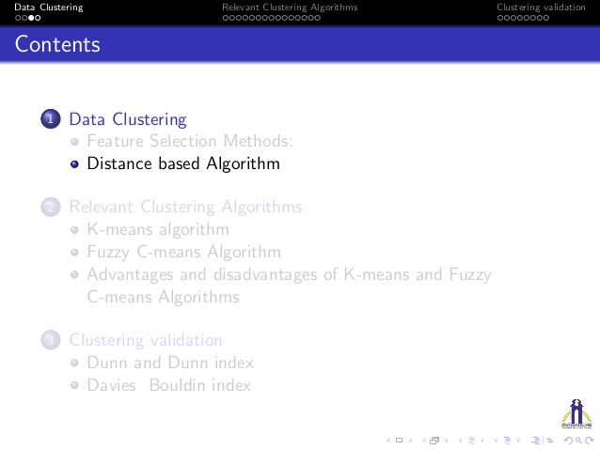

Slide 14
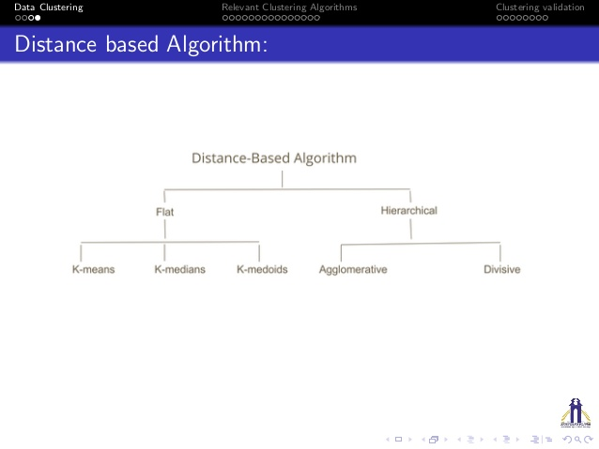

Slide 15
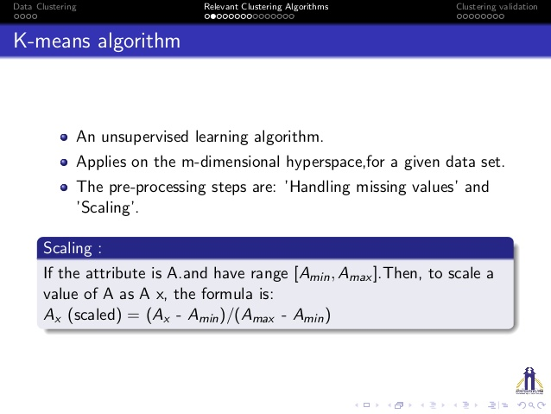

Slide 16
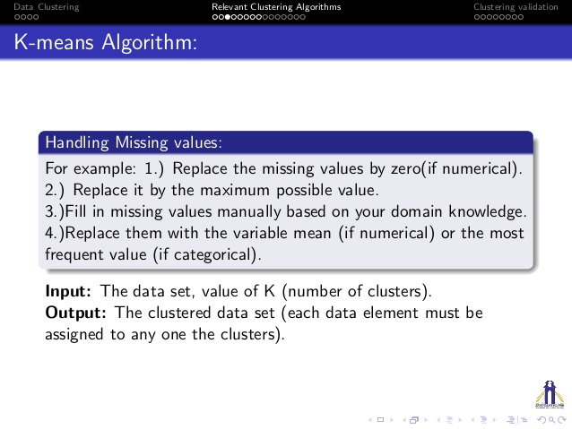

Slide 17
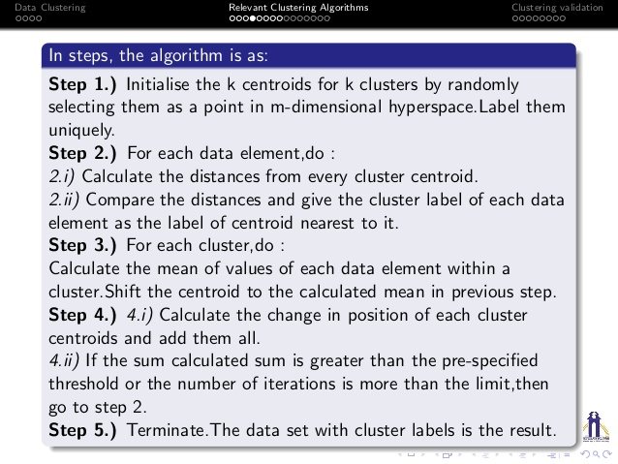

Slide 18
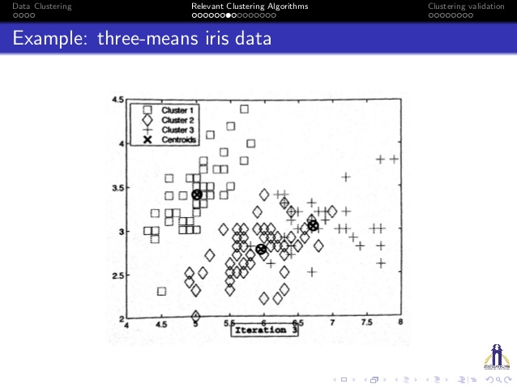

Slide 19
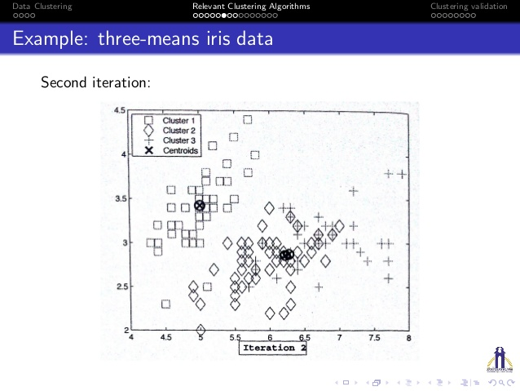

Slide 20
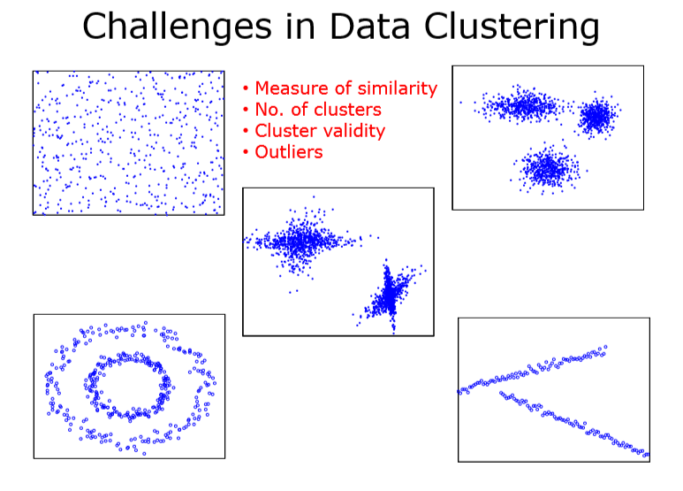

Slide 21
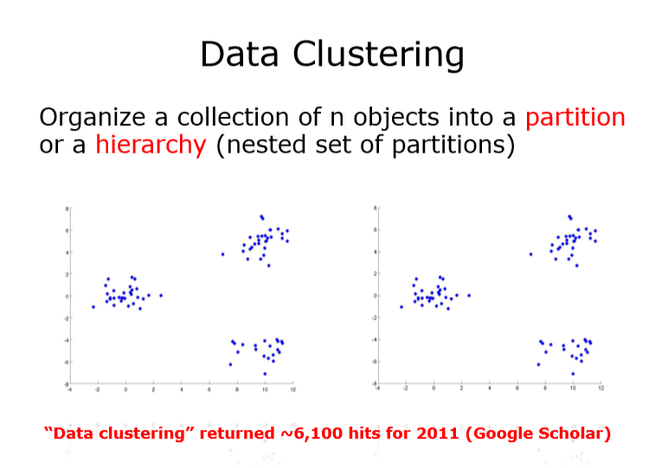

Slide 22
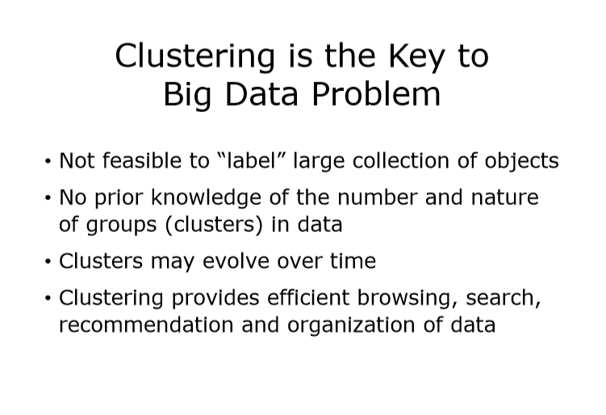

Slide 23
Advanced Analytical Theory and Methods: Association Rules

Slide 24
Key Concepts:
1. Association rules
2. Apriori algorithm
Support Confidence
Lift
Leverage

Slide 25
This is a descriptive, not predictive, method often used to discover interesting relationships hidden in a large dataset.
The disclosed relationships can be represented as rules or frequent itemsets.
Association rules are commonly used for mining transactions in databases.
Here are some possible questions that association rules can answer:
• Which products tend to be purchased together?
• Of those customers who are similar to this person, what products do they tend to buy?
• Of those customers who have purchased this product, what other similar products do they tend to view or purchase?

Slide 26
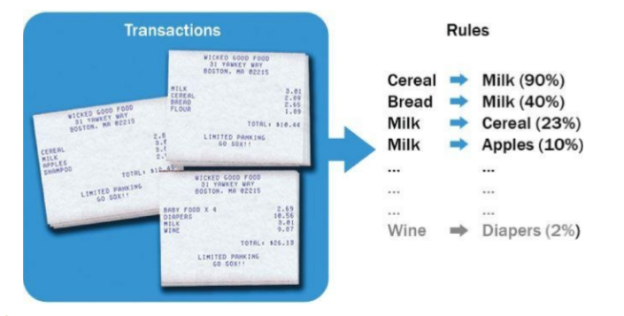
The goal with association rules is to discover interesting relationships among the items.

Slide 27
Each of the uncovered rules is in the form X → Y, meaning that when item X is observed, item Y is also observed. In this case, the left-hand side (LHS) of the rule is X, and the right-hand side (RHS) of the rule is Y.
An itemset containing k items is called a k-itemset ,
{item 1 ,item 2 ,… item k } to denote a k-itemset.
A frequent itemset has items that appear together often enough. The term “often enough” is formally defined with a minimum support criterion. If the minimum support is set at 0.5, any itemset can be considered a frequent itemset if at least 50% of the transactions contain this itemset.

Slide 28
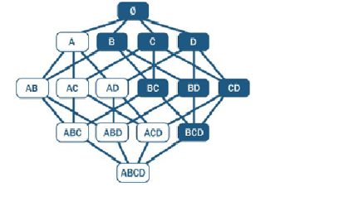
For example, if 60% of the transactions contain {bread,jam} , then at least 60% of all the transactions will contain {bread} or {jam} . In other words, when the support of {bread,jam} is 0.6, the support of {bread} or {jam} is at least 0.6.

Slide 29
What Is Frequent Pattern Analysis?
Frequent pattern: a pattern (a set of items, subsequences, substructures, etc.) that occurs frequently in a data set
Motivation: Finding inherent regularities in data
What products were often purchased together?— Beer and diapers?!
What are the subsequent purchases after buying a PC?
What kinds of DNA are sensitive to this new drug?
Can we automatically classify web documents?
Applications
Basket data analysis, cross-marketing, catalog design, sale campaign analysis, Web log (click stream) analysis, and DNA sequence analysis.

Slide 30
Why Is Freq. Pattern Mining Important?
Discloses an intrinsic and important property of data sets
Forms the foundation for many essential data mining tasks
Association, correlation, and causality analysis
Sequential, structural (e.g., sub-graph) patterns
Pattern analysis in spatiotemporal, multimedia, time-series, and stream data
Classification: associative classification
Cluster analysis: frequent pattern-based clustering
Data warehousing: iceberg cube and cube-gradient
Semantic data compression

Slide 32
Basic Concepts: Frequent Patterns and Association Rules
Transaction-id | Items bought
10 | A, B, D
20 | A, C, D
30 | A, D, E
40 | B, E, F
50 | B, C, D, E, F
Itemset X = {x₁, …, x_{k}}
Find all the rules X → Y with minimum support and confidence
support, s, probability that a transaction contains X ∪ Y
confidence, c, conditional probability that a transaction having X also contains Y
Customer
buys both
Customer
buys diaper
Let sup_{min} = 50%, conf_{min} = 50%
Freq. Pat.: {A:3, B:3, D:4, E:3, AD:3}
Association rules:
A → D (60%, 100%)
D → A (60%, 75%)
Customer
buys beer

Slide 33
Closed Patterns and Max-Patterns
A long pattern contains a combinatorial number of sub-patterns, e.g., {a₁, …, a₁₀₀} contains (₁₀₀¹) + (₁₀₀²) + … + (₁¹₀⁰₀⁰) = 2¹⁰⁰ – 1 = 1.27*10³⁰ sub-patterns!
Solution: Mine closed patterns and max-patterns instead
An itemset X is closed if X is frequent and there exists no super-pattern Y כ X, with the same support as X
An itemset X is a max-pattern if X is frequent and there exists no frequent super-pattern Y כ X
Closed pattern is a lossless compression of freq. patterns
Reducing the # of patterns and rules

Slide 34
Closed Patterns and Max-Patterns
Exercise. DB = {<a₁, …, a₁₀₀>, < a₁, …, a₅₀>}
Min_sup = 1.
What is the set of closed itemset?
<a₁, …, a₁₀₀>: 1
< a₁, …, a₅₀>: 2
What is the set of max-pattern?
<a₁, …, a₁₀₀>: 1
What is the set of all patterns?
!!

Slide 35
Scalable Methods for Mining Frequent Patterns
The downward closure property of frequent patterns
Any subset of a frequent itemset must be frequent
If {beer, diaper, nuts} is frequent, so is {beer, diaper}
i.e., every transaction having {beer, diaper, nuts} also contains {beer, diaper}
Scalable mining methods: Three major approaches
Apriori
Frequent pattern growth
Vertical data format approach

Slide 36
Apriori: A Candidate Generation-and-Test Approach
Apriori pruning principle: If there is any itemset which is infrequent, its superset should not be generated/tested!
Method:
Initially, scan DB once to get frequent 1-itemset
Generate length (k+1) candidate itemsets from length k frequent itemsets
Test the candidates against DB
Terminate when no frequent or candidate set can be generated

Slide 37
The Apriori Algorithm—An Example
Sup_{min} = 2
Itemset | sup
{A} | 2
{B} | 3
{C} | 3
{D} | 1
{E} | 3
Database TDB
Itemset | sup
{A} | 2
{B} | 3
{C} | 3
{E} | 3
L₁
Tid | Items
10 | A, C, D
20 | B, C, E
30 | A, B, C, E
40 | B, E
C₁
1st scan
C₂
Itemset | sup
{A, B} | 1
{A, C} | 2
{A, E} | 1
{B, C} | 2
{B, E} | 3
{C, E} | 2
C₂
Itemset
{A, B}
{A, C}
{A, E}
{B, C}
{B, E}
{C, E}
L₂
Itemset | sup
{A, C} | 2
{B, C} | 2
{B, E} | 3
{C, E} | 2
2nd scan
C₃
Itemset
{B, C, E}
3rd scan
L₃
Itemset | sup
{B, C, E} | 2

Slide 38
The Apriori Algorithm
Pseudo-code:
C_{k}: Candidate itemset of size k
L_{k} : frequent itemset of size k
L₁ = {frequent items};
for (k = 1; L_{k} !=∅; k++) do begin
C_{k+1} = candidates generated from L_{k};
for each transaction t in database do
increment the count of all candidates in C_{k+1} that are contained in t
L_{k+1} = candidates in C_{k+1} with min_support
end
return ∪_{k} L_{k};

Slide 39
Important Details of Apriori
How to generate candidates?
Step 1: self-joining L_{k}
Step 2: pruning
How to count supports of candidates?
Example of Candidate-generation
L₃={abc, abd, acd, ace, bcd}
Self-joining: L₃*L₃
abcd from abc and abd
acde from acd and ace
Pruning:
acde is removed because ade is not in L₃
C₄={abcd}

Slide 40
How to Generate Candidates?
Suppose the items in L_{k-1} are listed in an order
Step 1: self-joining L_{k-1}
insert into C_{k}
select p.item₁, p.item₂, …, p.item_{k-1}, q.item_{k-1}
from L_{k-1} p, L_{k-1} q
where p.item₁=q.item₁, …, p.item_{k-2}=q.item_{k-2}, p.item_{k-1} < q.item_{k-1}
Step 2: pruning
forall itemsets c in C_{k} do
forall (k-1)-subsets s of c do
if (s is not in L_{k-1}) then delete c from C_{k}

Slide 41
How to Count Supports of Candidates?
Why counting supports of candidates a problem?
The total number of candidates can be very huge
One transaction may contain many candidates
Method:
Candidate itemsets are stored in a hash-tree
Leaf node of hash-tree contains a list of itemsets and counts
Interior node contains a hash table
Subset function: finds all the candidates contained in a transaction

Slide 42
Example: Counting Supports of Candidates
Subset function
Transaction: 1 2 3 5 6
3,6,9
1,4,7
2,5,8
1 + 2 3 5 6
1 3 + 5 6
2 3 4
5 6 7
1 4 5
3 4 5
3 5 6
3 5 7
6 8 9
3 6 7
3 6 8
1 3 6
1 2 + 3 5 6
1 2 4
4 5 7
1 2 5
4 5 8
1 5 9

Slide 43
Challenges of Frequent Pattern Mining
Challenges
Multiple scans of transaction database
Huge number of candidates
Tedious workload of support counting for candidates
Improving Apriori: general ideas
Reduce passes of transaction database scans
Shrink number of candidates
Facilitate support counting of candidates

Slide 44
Partition: Scan Database Only Twice
Any itemset that is potentially frequent in DB must be frequent in at least one of the partitions of DB
Scan 1: partition database and find local frequent patterns
Scan 2: consolidate global frequent patterns

Slide 45
Exercises
1. What is the Apriori property?
2. Following is a list of five transactions that include items A, B, C, and D:
• T1 : { A,B,C }
• T2 : { A,C }
• T3 : { B,C }
• T4 : { A,D }
• T5 : { A,C,D }
Which itemsets satisfy the minimum support of 0.5? (Hint: An itemset may include more than one item.)
3. How are interesting rules identified? How are interesting rules
distinguished from coincidental rules?

Slide 46
Regression Analysis

Slide 47
Regression analysis is useful for answering the following kinds of questions:
• What is a person's expected income?
• What is the probability that an applicant will default on a loan?
Regression analysis is a useful explanatory tool that can identify the input variables that have the greatest statistical influence on the outcome.

Slide 48
Regression Analysis
Regression analysis is a useful explanatory tool that can identify the input variables that have the greatest statistical influence on the outcome.
For example, if it is found that the reading level of 10- year-old students is an excellent predictor of the students' success in high school and a factor in their attending college, then additional emphasis on reading can be considered, implemented, and evaluated to improve students' reading levels at a younger age.

Slide 49
Linear Regression
Linear regression is an analytical technique used to model the relationship between several input variables and a continuous outcome variable.
A linear regression model is a probabilistic one that accounts for the randomness that can affect any particular outcome.
Based on known input values, a linear regression model provides the expected value of the outcome variable based on the values of the input variables, but some uncertainty may remain in predicting any particular outcome.

Slide 50
Use Cases
Real estate: model helps set or evaluate the list price of a home on the market.
Demand forecasting: Businesses and governments can use linear regression models to predict demand for goods and services.
Medical: used to analyse the effect of a proposed radiation treatment on reducing tumour sizes.

Slide 51

Model Description
there is a linear relationship between the input variables and the outcome variable.
relationship can be expressed as shown in Equation
Y = β0 + β1x1 + β2 x 2.......... + βp-1 x p-1 + $∈$
where: y is the outcome variable xj are the input variables, for β0 is the value of y when each equals zero βj is the change in y based on a unit change in xj for j=1,2,...,p-1 ↋ is a random error term that represents the difference in the linear model
and a particular observed value for y.

Slide 52

Model Description
Income = β0 + β1Age + β2Education + $∈$
However, it is also obvious that there is considerable variation in income levels for a group of people with identical ages and years of education. This variation is represented by $∈$in the model.

Slide 53
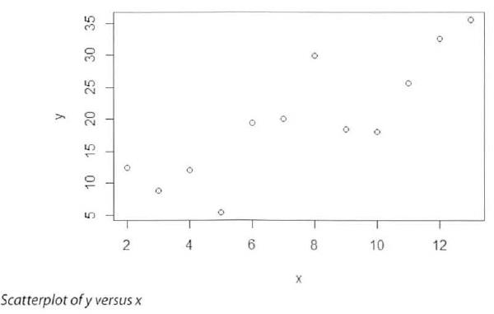
Linear Regression Model (Ordinary Least Squares)

Slide 54

Ordinary Least Squares (OLS) is a common technique to estimate the parameters.
suppose there is only one input variable, x, for an outcome variable y. Furthermore, n observations of (x, y) are obtained and plotted in below

